Slide 1
Geometry Tangents & Circles
Teacher : Nourhan Al-Sharif
Class : Gr 9
Subject : Mathematics

Slide 2
1- Relative positions of a point with respect to a circle:
Consider C(O, r) and a point A such that:
If OA< r then A is an interior point
If OA= r then A is a point on the circle
If OA> r then A is an exterior point
O
A
O
O
A
A

Slide 3
2- Relative positions of a line with respect to a circle:
Consider C(O, r) and a line (d) such that:
If distance from O to (d) < r then (d) is secant to the circle
If distance from O to (d) = r then (d) is tangent to the circle
If distance from O to (d) > r then (d) is exterior to the circle
(d)
(d)
O
(d)
O
O

Slide 4
Relative Position of two circles: a- Exterior circles
Consider C(O,4 cm) and C’(O’,2cm) where OO’ = 8 cm
R+R’ = 4+2=6cm
OO’ > R+R’
O
O’

Slide 5
b. Two interior circles:
O
Consider C(O, 4cm) and C’(O’,1cm)
R-R’ = 4-1 =3cm
OO’< R-R’
O’

Slide 6
c. Two circles tangent externally:
O
Consider C(O,4cm) and C’(O’ , 1cm) where OO’= 5 cm
R+R’ =4+1 =5 cm
OO’ = R+R’
O’

Slide 7
d. Two circles tangent internally:
O
Consider C(O,4cm) and C’(O’,1cm) where OO’ = 3cm
R-R’ = 4-1 =3 cm
OO’ =R-R’
O’

Slide 8
e. Two secant circles:
O
O’
Consider C(O,4cm) and C’(O’,1cm) where OO’ = 4 cm
R+R’ = 4+1=5cm
R-R’ =4-1 =3cm
R-R’<OO’<R+R’

Slide 9
Two concentric circles
Two circles (C1) and (C2) have the same center O but different radii
O
(C2)
(C1)

Slide 10
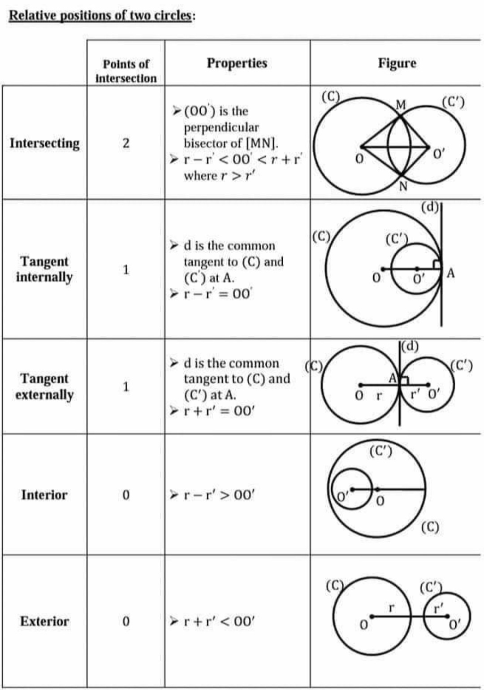

Slide 11
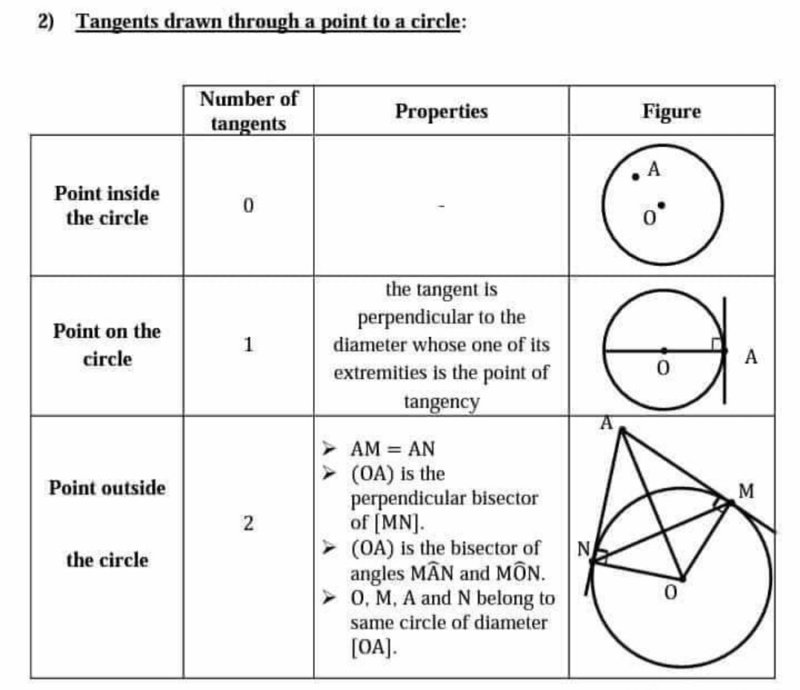

Slide 12
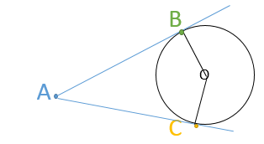
Property of two tangents issued from a point to the same circle:
AB = AC
[AO)i$s the bisector$ $of angle \hat{BAC}$
[OA)i$s the bisector$ $of angle \hat{BOC}$
(AO) is the perpendicular bisector of [BC]

Slide 13
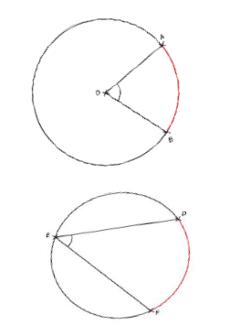
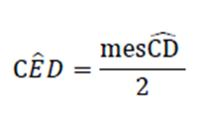
Arcs and Angles:
Central Angle:
It is an angle whose vertex is the center
of the circle
Inscribed Angle:
It is an angle whose vertex is a point on the circle

Slide 14
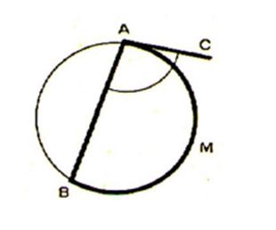
Note that the angle formed by a tangent and a chord is also considered as an inscribed angle.
Remark!
An inscribed angle facing diameter is always right (90 degrees)

Slide 15
Interior Angle:

Slide 16
Exterior Angle:

